Slide 1
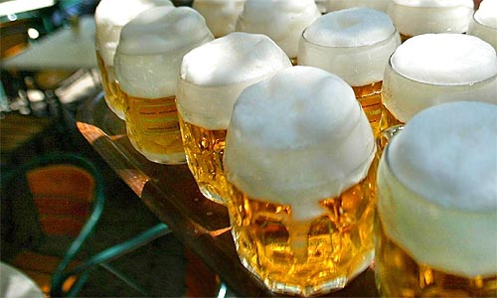
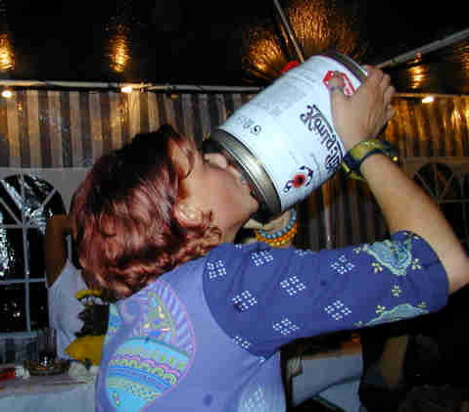
Open Source, Open Mind,
Open Bar:
Meet the JBoss team
Every day 18:00-20:00 with
FREE BEER

Slide 2
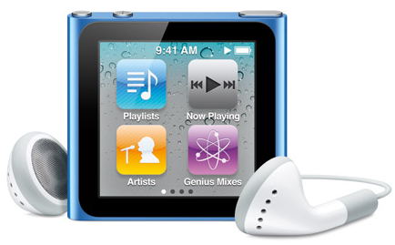
WIN AN IPOD NANO
DRAWING TODAY AT 19:00
Watch for your name on this screen and pick up your ipod.

Slide 3
THE WINNER IS....
Martin van Dijken
Take the JBoss Quiz NOW!

Slide 4
TODAY'S WINNER IS
Homer Simpson, Belgium

Slide 5


